Slide 1

CLINICAL FEATURES OF GINGIVITIS
RUNGTA COLLEGE OF DENTAL SCIENCES AND RESEARCH,BHILAI
Dr pushpendra yadav
Senior Lecturer
Dept of Periodontology

Slide 2
SPECIFIC LEARNING OBJECTIVES
Core areas | Domain | Category
Introduction | Affective | Desire to know
Classification | Cognitive | Must to know
Gingivitis | Cognitive | Must to know
Gingival Bleeding on Probing | Cognitive | Must to know
Course and Duration | Cognitive | Must to know
Clinical Findings | Cognitive | Must to know

Slide 3
content
PART I
Introduction
Classification
Gingivitis
Gingival Bleeding on Probing
PARTII
Course and Duration
Clinical Findings
Summary
Reference

Slide 4
COLOR CHANGES
tissue vascularity ,
epithelial thickness,
quantity of keratinization, and
pigments within the epithelium

Slide 5
The normal gingival color is “coral pink”
becomes RED
when vascularization increases or
the degree of epithelial keratinization is reduced or disappears
becomes PALE
when vascularization is reduced (in association with fibrosis of the corium) or
epithelial keratinization increases
venous stasis will contribute a bluish hue

Slide 6
In chronic inflammation.... interdental papillae, gingival margin, attached gingiva
acute gingival inflammation
may be marginal, diffuse, or patchlike, ..........depending on the underlying acute condition.
In acute necrotizing ulcerative gingivitis,
marginal
in herpetic gingivostomatitis,
diffuse
in acute reactions to chemical irritation,
patchlike or diffuse.

Slide 7
Intensity of the inflammation.
increase in erythema
only color change until the gingiva reverts to normal.
In severe acute inflammation
red color gradually becomes dull, whitish gray.
produced by tissue necrosis is demarcated from the adjacent gingiva by a thin, sharply defined erythematous zone.

Slide 8
Metallic Pigmentation
(…..bismuth, arsenic, mercury, lead and silver)
black or bluish line in the gingiva that follows the contour of the margin
isolated black blotches involving the interdental marginal and attached gingiva

Slide 9
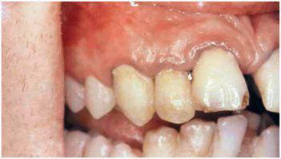
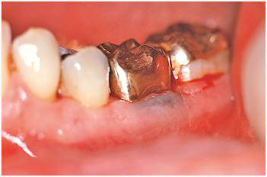
Bismuth gingivitis: linear black discoloration
Metal discoloration…..amalgam

Slide 10
Gingival pigmentation is not a result of systemic toxicity.
in areas of inflammation,
increased permeability of irritated blood vessels which permits
seepage & perivascular precipitation of metallic sulfides
into the epithelium & connective tissue
GINGIVAL PIGMENTATION

Slide 11
Color Changes Associated with Systemic Factors
ENDOGENOUS
EXOGENOUS

Slide 12
ENDOGENOUS
Bilirubin : Jaundice
Iron : Haemochromatosis
Pregnancy, diabetes, blood dyscrasias.
MELANIN- physiologic
Pathologic
  Addison’s disease- bluish black to brown.
  Peutz-Jeghers syndrome
  Albright’s syndrome (polyostotic fibrous dysplasia) and
  von Recklinghausen’s disease (neurofibromatosis)

Slide 13
EXOGENOUS
atmospheric irritants, such as coal and metal dust, and
coloring agents in food or lozenges.
Tobacco
amalgam -Localized bluish black

Slide 14
GINGIVAL CONSISTENCY

Slide 15
CHRONIC GINGIVITIS
Clinical Changes | Underlying Microscopic Features
Soggy puffiness that pits on pressure. | Infiltration by fluid and cells of inflammatory exudate.
Marked softness and friability, with ready fragmentation on exploration with probe and pinpoint surface areas of redness and desquamation | Degeneration of connective tissue and epithelium associated with injurious substances that provoke the inflammation and inflammatory exudate; change in connective tissue–epithelium relationship, with inflamed, engorged connective tissue expanding to within a few epithelial cells of surface, thinning of epithelium and degeneration associated with edema and leukocyte invasion, separated by areas in which rete pegs are elongated to connective tissue

Slide 16
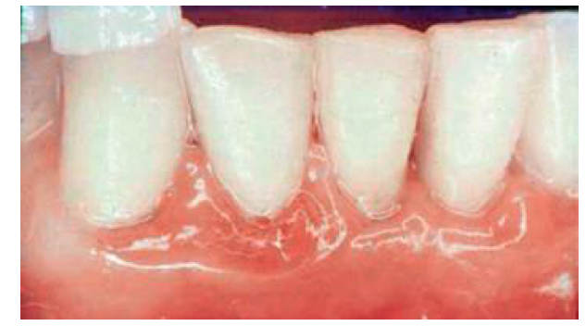

Slide 17
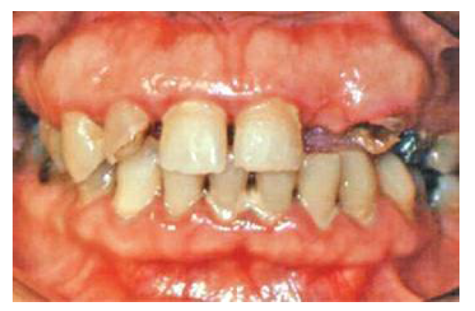
Clinical Changes | Underlying Microscopic Features
Firm, leathery consistency. | Fibrosis and epithelial proliferation associated with long-standing chronic inflammation.

Slide 18
Acute Forms of Gingivitis
Clinical Changes | Underlying Microscopic Features
Diffuse puffiness and softening. | Diffuse edema of acute inflammatory origin, fatty infiltration in xanthomatosis
Sloughing with grayish, flakelike particles of debris adhering to eroded surface | Necrosis with formation of pseudomembrane composed of bacteria, polymorphonuclear leukocytes, and degenerated epithelial cells in fibrinous meshwork
Vesicle formation. | Intercellular and intracellular edema with degeneration of nucleus and cytoplasm and rupture of cell wall.

Slide 19
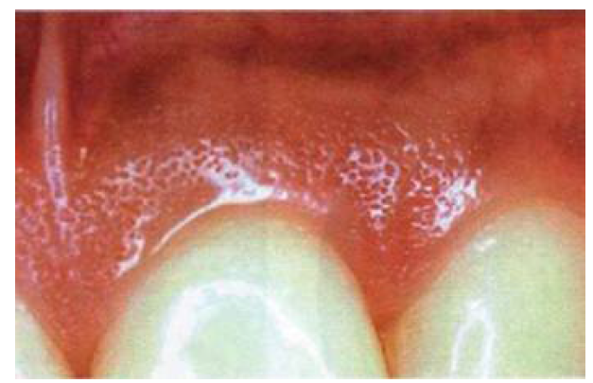
Changes in Surface Texture of the Gingiva

Slide 20
loss of stippling is an early sign of gingivitis
In chronic inflammation ...........the gingival surface is either smooth and shiny or firm and nodular
In chronic desquamative gingivitis..... peeling of the surface
Hyperkeratosis .......a leathery texture, and
Drug-induced gingival overgrowth ........nodular surface

Slide 21
Changes in Position of the Gingiva
Coronal to CEJ
At the CEJ
Apical to CEJ
RECESSION

Slide 22
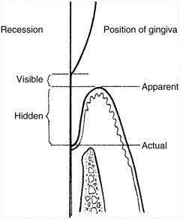

Slide 23
Etiologic factors for gingival recession….
faulty toothbrushing technique (gingival abrasion),
tooth malposition,
friction from soft tissues (gingival ablation),
gingival inflammation,
abnormal frenum attachment, and
iatrogenic dentistry
Trauma from occlusion

Slide 24
Clinical Significance
Exposed root surfaces are susceptible to
Caries
sensitive…..Abrasion or erosion of the exposed cementum
Hyperemia of the pulp and associated symptoms
Interproximal recession creates oral hygiene problems.

Slide 25
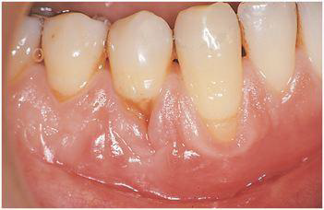
Changes in Gingival Contour
In Recession…..Accentuated
“Stillman’s clefts” narrow, triangular-shaped gingival recession
“McCall festoons” rolled, thickened band of gingiva usually seen adjacent to the cuspids

Slide 26
summary
Gingivitis can be classified based on duration as acute, chronic, and recurrent gingivitis.Based on the involvement of teeth it can be classified as localized and generalized gingivitis.
Based on the location gingivitis can be classified as marginal, attached and papillary gingivitis. Gingival disease in individual cases can be described by combining location, and involved teeth.

Slide 27
Reference
Newman MG, Takei HH, Klokkevold PR, Carranza FA. Carranza’s clinical periodontology, 10th ed. Saunders Elsevier; 2007.
Lindhe J, Lang NP and Karring T. Clinical Periodontology and Implant Dentistry. 6th ed. Oxford (UK): Blackwell Publishing Ltd.; 2015.
Newman MG, Takei HH, Klokkevold PR, Carranza FA. Carranza’s clinical periodontology, 13th ed. Saunders Elsevier; 2018.

Slide 28
THANK YOU

